Slide 1
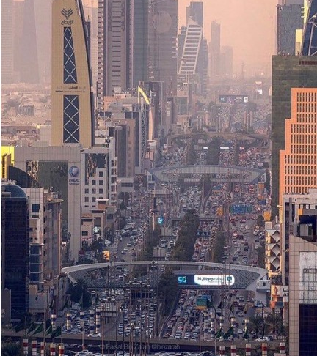

C2C
E-COMMERCE PLATFORM
Content
Introduction
Team
Concept and target market
Business objectives
Business setup
Performance
Summary
New business venture opportunity
June 2025
By
Jeddah - KSA

Slide 2
Our Business Objectives
SALES TARGET
REVENUE STREAMS
PROFIT GOAL
ADDITIONAL REVENUE
5.7K
15%
1.5K
++
Achieve SR 5.7 thousand in platform sales trades by the second year of operation
Net expected platform revenue will be generated from:
17% commission on trading volume.
5% commission on sales generated by the Achmad Corp. Contracting Sales Force team.
Target a net income of
SR 1.5 thousand by the end of the second year of operation
Additional revenue from local brand shops' membership fees for marketing.

Slide 3





Why initiate such a Concept
Market Shift
01
Online business is rapidly accelerating in KSA, especially post-COVID-19, marking
a swift shift from traditional transactions.
02
Untapped Opportunity
Most KSA toys transactions remain traditional (cafe-to-cafe, home-to-shop), creating a clear opportunity for
a specialized online toys platform.
Gap in Current Platforms
03
Existing online platforms don't specialize in toys for toddlers, failing to meet specific potential customer needs.
04
Addressing Corporate Needs
Corporations need easier sourcing.
A comprehensive hub with full product info and school locations will solve key procurement challenges for managers.
Fostering Competition
05
A multi-toddler, multi-parent platform will foster competition, leading to better prices and improved service to satisfy and retain clients.

Slide 4



The Strategy
Database Development
Schools Alliances
Market Awareness
Build the largest national toys database
Form strong alliances with international schools for paid membership and toys data
Aggressively build platform awareness in the C2C toys market via a dedicated sales team.
01
02
03
04
05
Key Client Relations
Direct Sales Force
Establish a 'special care' team for key corporate clients (e.g., ToysRUs, Hussain Toys, Jarir)
Develop an in-house sales force to secure volume contract deals for large projects via the schools

Slide 5
Critical Success Factors
Local Schools
Early local vendor adoption ensures high platform value.
UI/UX
Intuitive, easy-to-navigate platform attractive to all, covering broad product range.
International Student Membership
Big-name international vendors provide key platform value via product info and training.

Slide 6
The Target Market
SYRIA
Geographic Focus
LEBANON
IRAQ
Our initial target market is KSA, with future expansion planned for other Middle East countries after local goals are met.
JORDAN
KUWAIT
KSA Market Potential
BAHRAIN
SAUDI
ARABIA
QATAR
The Saudi market, with the Middle East's largest GDP, offers vast opportunities driven by Vision 2030.
U A E
OMAN
Market Size
Based on 2018 import statistics, and accounting for distributor margins, the hand and power tools market is approximately SAR 9 thousand annually at retail.
YEMEN

Slide 7
Sales Breakdown
Segment | # of POS (Market Share) | Annual Sales per POS (SAR) | Total Sales (SAR) | Total Sales (%)
Through Wholesalers & Retail POS | 1,000 (100%) |  | 440 Thousand | 70%
Distributors and Medium Retails | 545 (55%) | 5 Million | 272 Thousand | 33%
Mega Wholesalers & Importers | 430 (53%) | 50 Million | 125 Thousand | 25%
Small Retails | 25 (2%) | 1 Million | 43 Thousand | 12%
Direct to Corporates (Factories, Projects) |  |  | 293 Thousand | 30%
TOTAL |  |  | 733 Thousand | 100%
70%
Through Wholesales & Retails

Slide 8
Expected Performance
Future Is
Promising
The plan will be rolled out in 3 phases
10 months
10 months
10 months
First phase
Second phase
Third phase
Legal Setup of Colledge
IT Infrastructure: Platform development, ERP system integration, and other essential operational.
Office Setup and Initial Staff Hiring
Form Alliances with travel Partners
Trial online trading (internal/testing)
Increase team members from 40 to 120
Soft Launch of Platform
Invite International visitors to Onboard
Launch Sales Plan to Recruit visitors
Increase Team to 180
Expand network Base
Intensify Marketing Campaign
Sustain Growth

Slide 9
Investment Requirements
Key IT infrastructure investments include data center development and recording system for integration.
Total (SAR):
37K

Slide 10



Revenue Expectation
2.8K
Second year
Total Revenue
Comprehensive earnings from all operational activities on the platform
Multi-Channel Revenue
Revenue generated from offline & platform visiting, primarily commissions on data volume
885
First year
Membership Revenue
Revenue derived from international schools' membership fees for toys merchandising

Slide 11
Revenue Outlook
Item | First Year Revenue (SAR) | Second Year Revenue (SAR)
Online B2B vendors transactions | 110K | 1.1B
Direct contracting by the ACHMAD CORP sales force | 400K | 450M
International Manufacturer Membership | 90K | 150M
Total | 650K | 1.7B
Sales from direct communities are expected to begin at low volume in the first day. Revenue generation from online trading will significantly increase in the second week (week 37-42) as students onboard the platform.
We project revenue to continue increasing as more students onboard the platform and realize its value throughout the second week. The total revenue from both platform transactions and communities' fees will be as follows:

